Slide 1
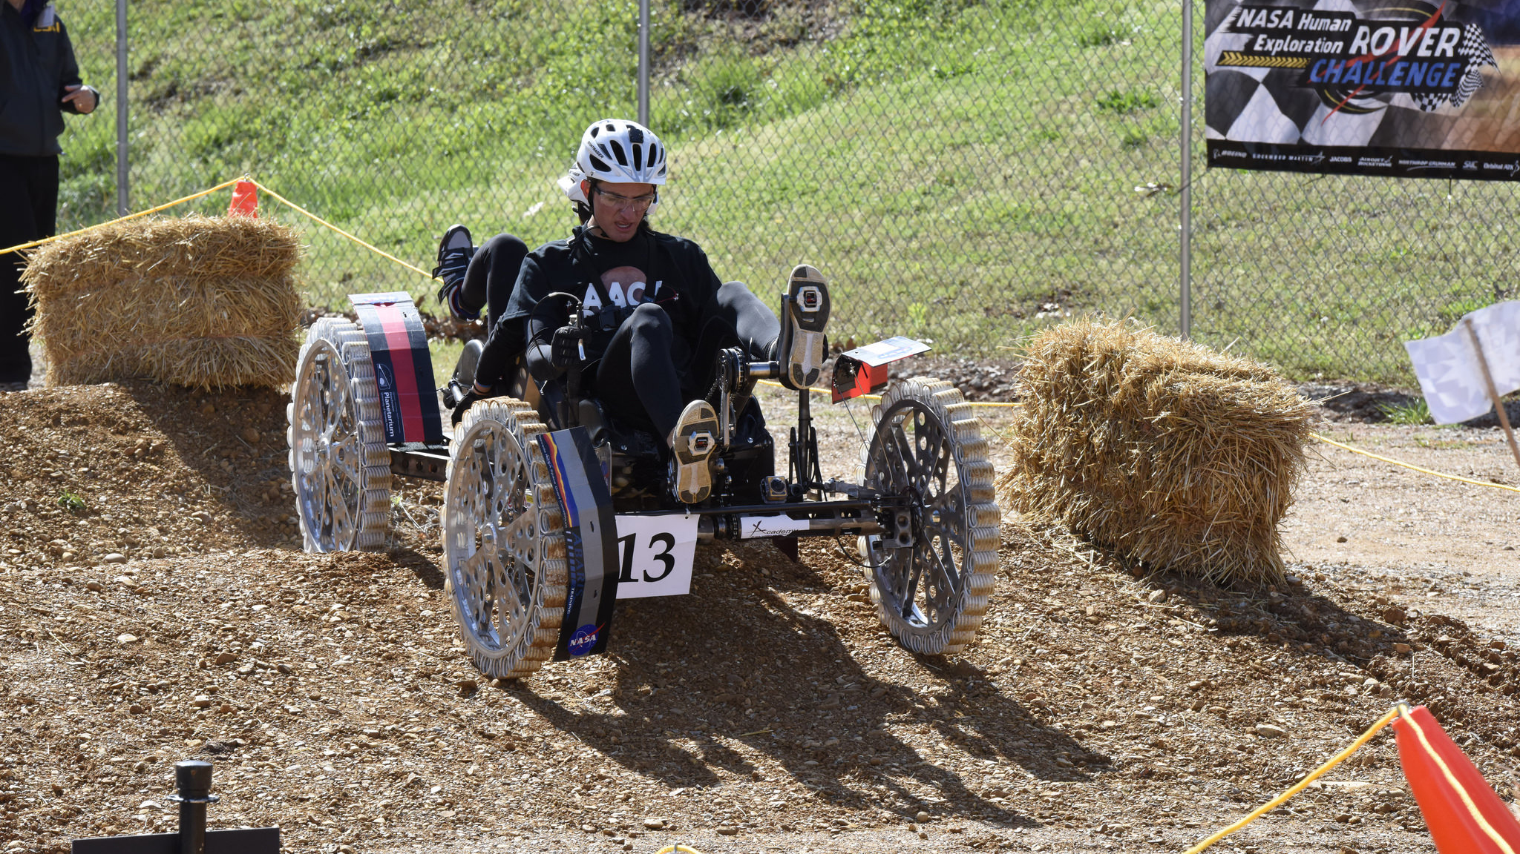


NASA
HUMAN EXPLORATION ROVER CHALLENGE 2023

Slide 2


Slide 3
Table of Content
S.No. | Content
1. | Steering
2. | Brakes
3. | Wheels
4. | Chassis
5. | Drivetrain
6. | Suspension
7. | Sample Retrieval tool
8. | PHA
9. | DFMAE

Slide 4
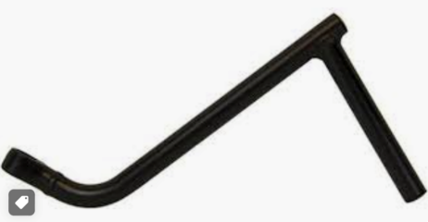
Steering
We came across two different steering system i.e. ackerman steering system and skid steering system. Both have their own advantages and disadvantages. In case of ackerman steering system the inner wheel turns more than the outer wheel to effectively steer the vehicle without any slip whereas in skid system The advantage of a skid-steer is increased traction and no "caster wheel effect.
For operating the rover, we are using side handlebars of area approximately 12.56 cm sq. Each due to the following reasons:
Better grip for both the drivers with both hands.
Better control of directions.
Does not affect the folding mechanism of the rover.
Fits right in place according to the dimensions of the rover

Slide 5
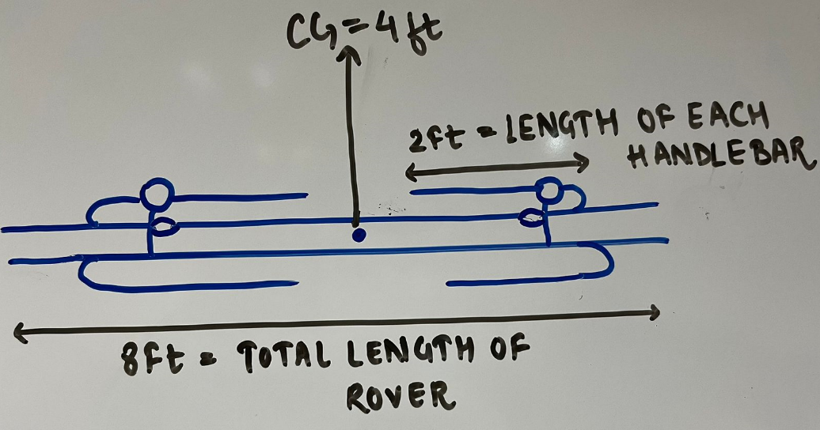
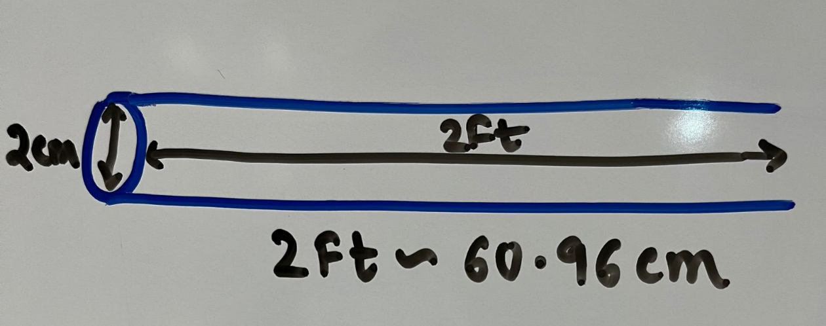
MATERIAL USED FOR HANDLEBARS:
Aluminium is the material we chose due to the following reasons:
Aluminium handlebars are extremely durable
Volume of each side handlebar = πr 2h = π x 2 2 x 60.96 = 765.65 cm3
Weight of each side handlebar = density x volume = 2.067255 kg
Cost of 1kg Aluminum = 140 INR
Weight of 4 side handlebars = 2.067255 x 4 = 8.26902 kg
Cost of 4 side handlebars = 8.26902 x 140 = 1,157 INR ($14)

Slide 6
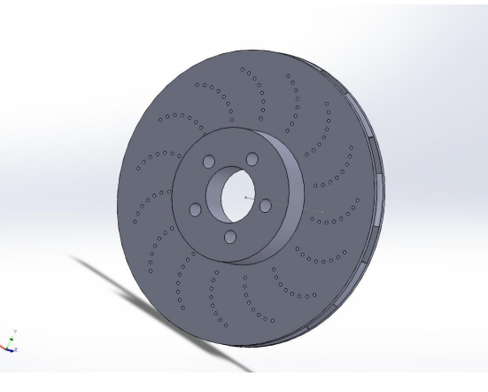
BRAKES
Drum brakes-
● Requires less force to apply brakes.
● They are cost-effective.
● No fluid is used.
● It is self-locking.
● These brakes have 20 to 30 percent more weight than disk brakes.
Disk Brakes-
● Less effort and produces greater braking force
● Good heat dissipation
● Easy Installation
● Fluid is used
● It is more efficient and when we stop it stops fast as compared to the drum brake. Better ventilation properties.
We will use disc brakes in our rover on all front and rear wheels.

Slide 7
1. Hydraulic Disc Brakes
● Use both pads to create more effective frictional force.
● Less everyday wear and tear.
In hydraulic disk brakes the frictional force is applied from both the sides. Unlike mechanical.
● Better modulation & stopping power.
2. Mechanical Disc Brakes
● Comparatively less modulation and stopping power.
Overall, hydraulic disc brakes are superior in terms of performance and efficiency because of the reduced friction by not having a mechanical cable and reducing wear and tear of cables.
Reasons to use Hydraulic disc brakes at the front and rear wheels.
The stopping of vehicles results in more weight on front tires and axles. Now since the disc brakes are more efficient and can bear more weight, they are used on front wheels. While climbing the slopes, we will also need to stop the vehicle from moving backward, so at the rear wheels, we will also use disk brakes. We discard the other options of breaking because either they are heavier or very complex to implement into a rover. As the design of our rover needs brakes for both the drivers sitting at the back and the front, we will be using the brakes in all four tires according to the dual braking system. In a split or dual braking system, pressure to the brakes is applied to the wheels on separate lines carrying a special Hydraulic fluid. There are two basic types of split braking systems, viz. a front, and rear split system and the second is known as a diagonal split braking system.

Slide 8
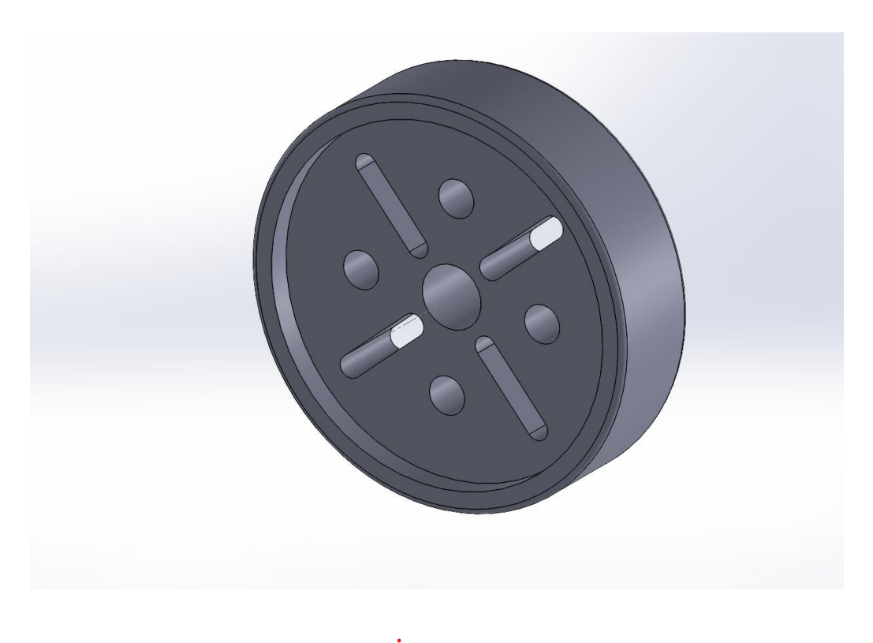
WHEELS
Materials that can be used for rim:-
● Aluminum
● Stainless steel
● Moulded rubber
● Plastic
● Wood
Aluminum :-
It’s extremely machinable and light weight. Extremely expensive machining tools needed to make wheels out of a solid block of it.
Stainless steel :- It is extremely heavy but also machinable. Welding stainless steel is extremely easy, but the weight constraints remove it from the running.
Moulded rubber :- Extremely durable and lightweight. It gets deformed easily. Small quantities of tires cannot be manufactured using this method as it is only suitable for mass manufacturing.
In conclusion Aluminum is the most suitable material for our tire rims as it’s extreme.

Slide 9
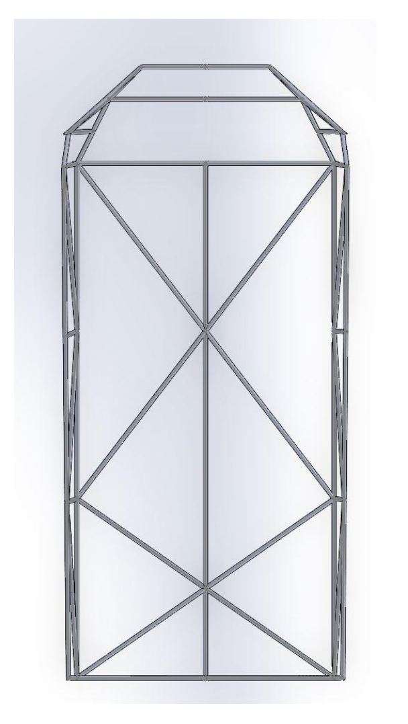
CHASSIS
Rover is a vehicle for exploring the surface of a planet or moon. For, this competition, it is supposed to be designed to four non-pneumatic tires and be capable of traversing on the land of other planets.
The chassis of a rover is a skeleton structure that supports systems such as suspension, steering, and the powertrain. For this reason, the chassis of an all-terrain is designed by considering factors such as the safety of the driver, ease of manufacturing, sustainability, compactness, lightweight and ergonomics design.
The special requirements of a rover, like the need of better stability and safety is done by providing a stable chassis structure, which is the basic load bearing framework of the rover.
Some factors which must be kept in mind while designing the chassis is –
● Human ergonomics
● Manufacturing
● Strength of materials
● Factor of safety

Slide 10
The design and establishment process of the chassis involves various considerations, namely material selection, cross section determination, chassis design, and finite element analysis. One of the critical design decisions that enhance the reliability, safety, and performance of any vehicle structure is the material choosing.
The material selection for the chassis is Grade 2024-T3 is the most common high-strength aluminium alloy. It is often considered aircraft quality. It has excellent fatigue resistance even though its corrosion resistance is lower than that of 6061.
Metal Grade | Aluminium Alloy Grade 2024-T3 | Stainless Steel Grade 304 | Magnesium AZ91D-F | Aluminium 7075-O | Titanium Ti-6Al-$V (Grade 5)
Density | 2.78 g/cc | 8.00 g/cc | 1.81 g/cc | 2.81 g/cc | 4.43 g/cc
Poisson Ratio | 0.33 | 0.29 | 0.35 | 0.33 | 0.342
Elongation | 20% | 70% | 03% | 17% | 14%
Shear Modulus | 4060 ksi | 11200 ksi | 2470 ksi | 3900 ksi | 6380 ksi
Tensile Strength | 41000 psi | 73200 psi | 33400 psi | 33000 psi | 138000 psi

Slide 11
The legs of the rover, which will have the maximum load will be constructed with stainless steel AISI 4130 as it has the most tensile strength and a density of 7.85 g/cm3 which will help us in keeping the rover strong and durable to bear the weight.
Approximate weight of legs = 3.993 kg
if the size of each leg is 50 cm and provided, we are using pipes of outer diameter 3 cm and internal diameter 2.4cm
The body of the rover will be made of Aluminium Alloy Grade 2024-T3 because it has a density of 2.78 g/cc and will consist of about 70% of the rover, helping us in making it lightweight and durable for use. 41000 psi is just enough for the body to handle the weight of the drivers and any obstacle we will face.
Approximate weight of chassis=12.8 kg
provided we are using pipes of outer diameter 3 cm and internal diameter 2.8cm.
The gearbox and mechanisms will be made of Stainless-Steel Grade 304 as it is an economically feasible option. Furthermore, it has one of the highest tensile strengths, which we require as we cannot afford for such an essential component of the rover to fail.
Approximate weight of the drivetrain = 10 kg

Slide 12
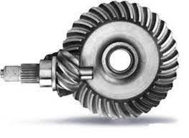
DRIVETRAIN
We researched various types of ways to power the vehicle manually, where our primary focus was not to use chain and sprocket system ,as it was not encouraged in the competition.
Other ways which were best included belt drive system and gearboxes.
Belt drive system was a good and simple alternative to use and power our rover, but its biggest drawback is that it can not be used at places with high torque applications as they start slipping after a certain amount of force.
Overall, after thorough comparison, consideration and as per our need, we concluded that gearboxes were better than any other way to power our rover.
The parts required in building the drive train will be bevel gears, gearbox, and differentials. There are two modes of transmission in this proposed model of drivetrain. One is high rpm and moderate torque associated with the front axle and the other is low rpm and high torque associated with the rear axle. The rear wheels have larger wheel diameter than the front wheels resulting in more grip and torque, whereas the front wheels will be relatively smaller in size resulting in more rpm helping in traversing the course faster.
Approximate weight of the drivetrain = 10 kg

Slide 13
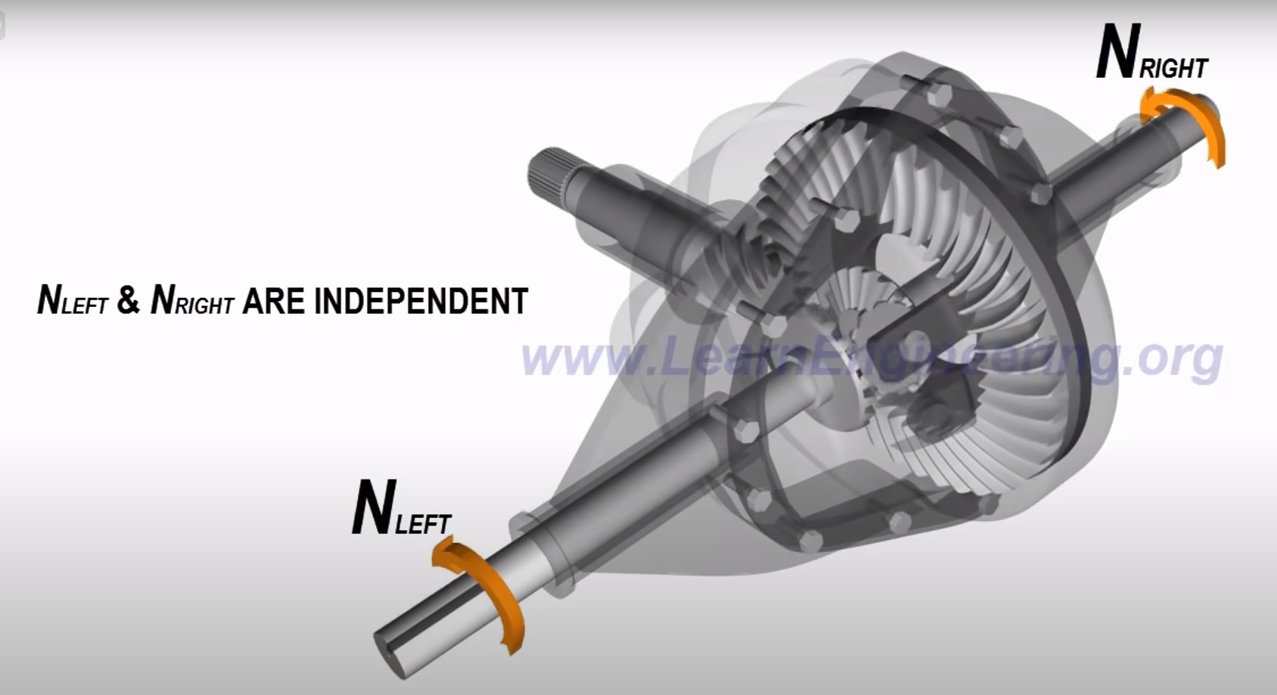
The type of gear which will be used in this configuration is a hypoid gear as it suits the requirements and will not slip when in use. Also, this is the best option when it comes to fold the chassis.
For the front axle, we will attach the pedals to the gearbox which further will be connected to the differential which will be connected to the wheels. For rear axle, we have planned to attach the pedals to the gearbox. This gearbox will be connected to the differential at the back via shaft. This differential will be further connected to the wheels. The rear gearbox will have a higher gear-ratio as it is required to give more torque whereas the front gearbox will have a lower gear-ratio to attain a higher rpm.

Slide 14
Suspension
Air shocks
An air suspension system is a style of vehicle suspension that's powered by an electric pump or compressor that pumps air into flexible bellows that are typically made out of a textile-reinforced type of rubber.
Several key features are as follows:
Vulcanized, heavy-duty rubber air springs at each of the vehicle's wheels
An air compressor in the vehicle's trunk or under the hood of the vehicle
A storage tank for compressed air, which allows you to store air at around an average of 150 PSI
Air pipes connecting from the storage tank to the air springs that channel the flow of air throughout the suspension system
Valve blocks which direct air to the four springs from the storage reservoir through a set of solenoids, valves, and o-rings

Slide 15
Coilover Suspension
A Coilover suspension (also called a screw suspension) refers to a suspension that allows individual adjustment of the ground clearance. This is done by means of a screw thread on the suspension strut. For this reason, a car with a Coilover suspension can also be raised or lowered quickly and without tools by private individuals.
In addition to flexible lowering, most Coilover suspensions also have other adjustment options. In addition to the hardness, the driver can often also adjust the rebound or compression damping.
In this way, Coilover suspension allows optimal adjustment to personal preferences, the vehicle setup, the track, and external conditions.
High-performance coilovers for club and racing sports
Coilovers feature independently adjustable compression and rebound damping settings, as well as full-length ride height adjustment. This suspension system is ideal for enthusiasts desiring excellent handling when they participate in occasional track days, weekend race events, club circuit races, or less aggressive road competitions. This kit allows for adjustable damping setups for daily driving without sacrificing ride comfort. The external reservoir allows for increased oil capacity to dissipate heat superiorly, which enables you to use the coilovers for a long period of time without failure and improves the performance & handling of your vehicle substantially.

Slide 16
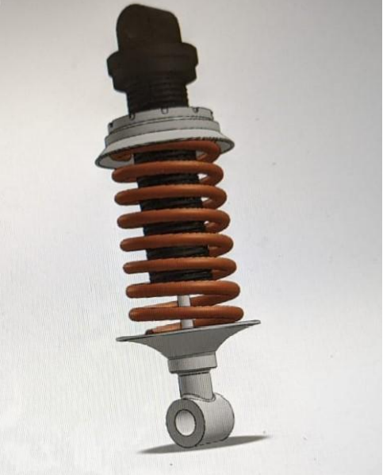
Conclusion: Keeping all the pros and cons of 3 types of suspension systems, We have decided to use Coilover suspension as they are extremely cost-effective and can be tailored to our requirements. They also don't need any external equipment to function.

Slide 17
Sample collection
Selfie stick and cup : This method is extremely ingenious and allows for an extremely simplistic design while being lightweight and compact. The only problem with this method is that it can’t be manoeuvred into tight spaces and can not go into areas that are not completely straight.
Electronic vacuum pump with single use sample collection containers: This allows us to collect samples without putting in any effort from the driver as all the work is done by an electric motor in the pump. The problem with this design is that it is extremely difficult to prevent cross contamination.
Large syringe: This method consists of us using a large syringe in combination with vinyl tubing and a fishing rod. The large syringe creates a vacuum strong enough to collect the sample while also doubling as the sample collection container. The fishing rod is used to reach spaces that are too high for the driver to reach on his own.
In conclusion the most effective method for sample collection is the large syringe method as it is the lost space efficient, effective and lightweight.

Slide 18
Personnel Hazard Analysis
S No. | Phase | Types of Hazards | Hazards | Preventive Actions
1. | Manfucaturing | Metal welding | Health issues related to eyes, skin. | Respiratory protective equipment. Fire resistant clothing.
 |  | Metal Cutting | Exposure to metal fumes and to ultraviolet radiation. | Use face shield. Safety glasses are required.
 |  | Drilling | Includes respiratory problems. | Don’t wear loose clothing or gloves. Safety gloves, googles, work boots.
 |  | Bending | Operator's hands being caught and drawn into the in-running nip, can lead to injuries. | Install a safety clip or retainer . Wear clothing that fits well.
 |  | Riveting | May suffer eye injuries caused by flying pieces of metal. | Use proper safety tools.
 |  | Shearing and Forming | Injuries includes crushing of tissues, breaking of bones. | Use of correct tools, safety gloves, proper equipment.
 |  | Machining | Risk of injuries, noise, vibrations. | Wear safety glasses or goggles.
2. | Excursion | Mechanical Moving Parts | Can cause shock, fractures, dislocations if encountered worker’s body | Wear appropriate personal protective equipment.
 |  | Impact | A person can strike an object or can be struck by a moving object | Wear appropriate safety gears
 |  | Crush or Pinch | An object or machine can crush or pinch the body. | Never walk away from a machine that is turned on or coasting
 |  | Breaking of a part | Sharp edges can cause cuts and other injuries, people can be struck | Wear seat belt, avoid distractions

Slide 19
